Slide 1
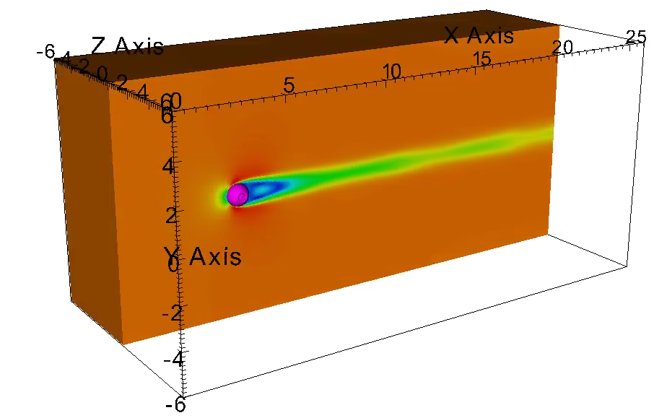



Validating a Novel CFD Algorithm by Finding the Drag Coefficient of a Sphere
By: David “Jack” Madden
Arizona State University
2021 Arizona/NASA Space Grant
Undergraduate Research Symposium
Honors Thesis Committee Chair: Mohamed Houssem Kasbaoui, Ph. D.
Honors Thesis Second Committee Member: Marcus Herrmann, Ph. D.
April 17th, 2021

Slide 2

Introduction
The Kasbaoui Research Group (KRG) has developed a Novel algorithm for use in Computational Fluid Dynamics (CFD)
Previous testing has focused on two dimensions, but now the algorithm must be proven to work in three dimensions before development can continue

Slide 3
Goals
Validate that the novel algorithm worked successfully in three dimensions
Determine the simulation parameters required to compute the hydrodynamic forces on a submerged solid with high-fidelity

Slide 4


Navier Stokes Equations
Mass Conservation
Momentum Conservation
$$\frac{∂ρ}{∂t}+\vec{v}∙∇ρ=0$$
$$ρ\left(\frac{∂v}{∂t}+\left(\vec{v}∙∇\right)\vec{v}\right)=−∇p+ρ\vec{g}+μ∇^{2}\vec{v}$$

Slide 5
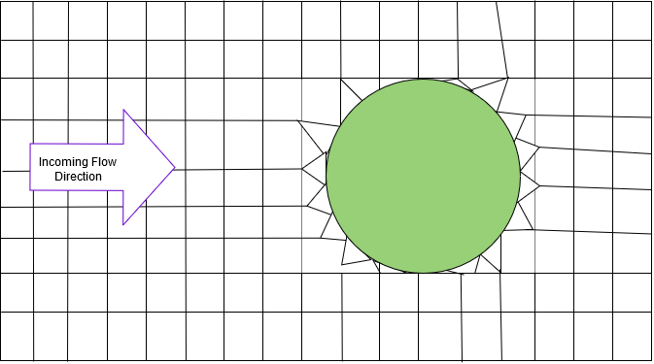
Body Conforming Meshes

Slide 6
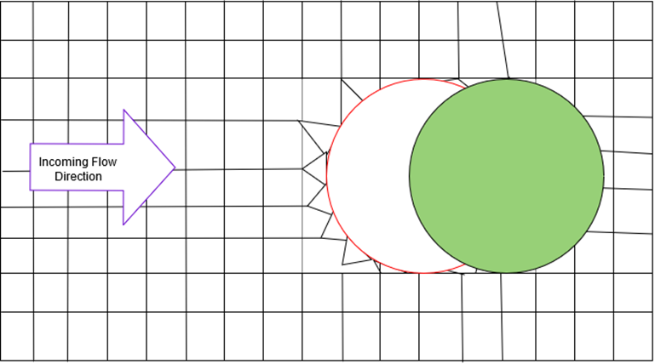
Body Conforming Meshes Continued

Slide 7


Immersed Boundary Method
$$ρ\left(\frac{∂v}{∂t}+\left(\vec{v}∙∇\right)\vec{v}\right)=−∇p+ρ\vec{g}+μ∇^{2}\vec{v}+{\vec{F}}_{IB}$$
$${\vec{F}}_{IB}\left(\vec{x},t\right)= \iint_{\vec{y}∈S_{IB}}^{ }{{\vec{f}}_{IB}\left(\vec{y},t\right)δ\left(\vec{x}−\vec{y}\right)dS}$$

Slide 8
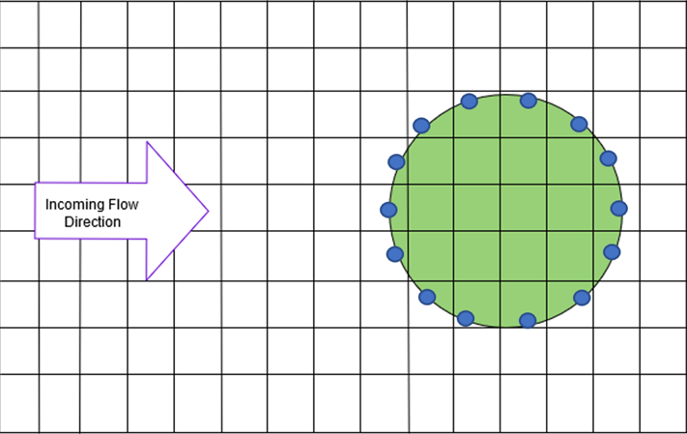
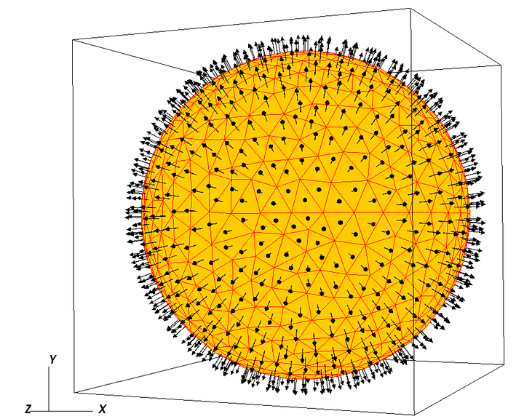
Immersed Boundary Method Continued

Slide 9
Advantages of IBM
Reduced Computational Cost
Better Particle Resolved Direct Numerical Simulations

Slide 10
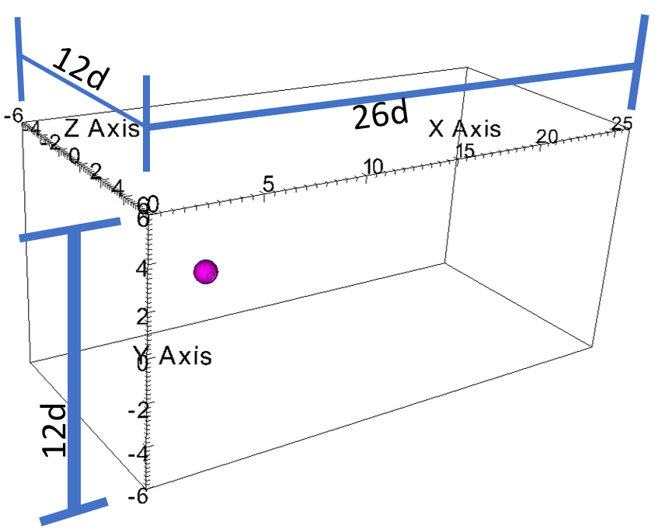
Methodology
12d
Reynolds Numbers =
10, 25, 50, 100, 200, 300
d/Δx = 6, 12, 24
12d
CFL = 0.10, 0.25

Slide 11
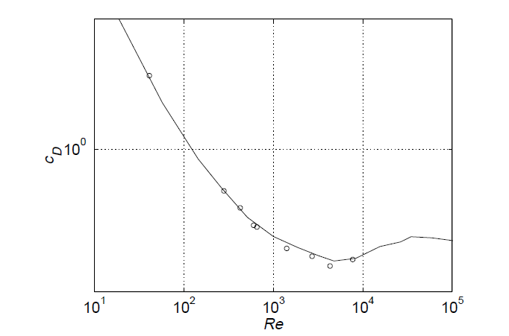
Schiller Naumann Correlation
Mordant & Pinton, The European Physical Journal B - Condensed Matter and Complex Systems , 2000

Slide 12
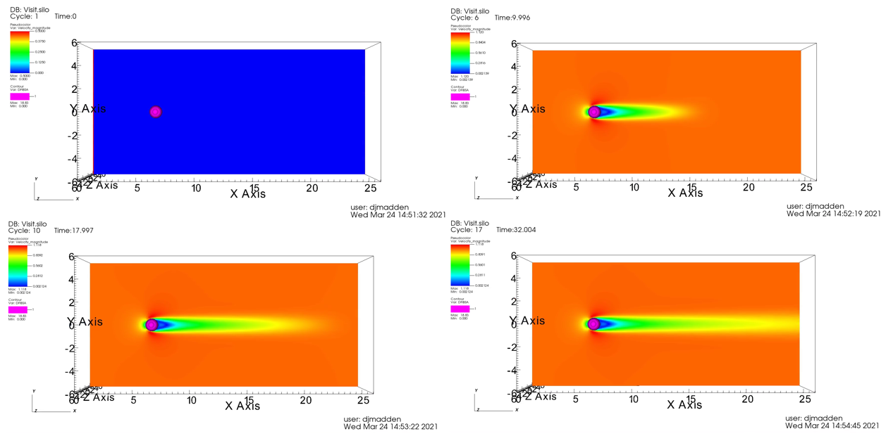
Qualitative Analysis of Re = 100, d/Δ x = 12, CFL 0.25

Slide 13
Drag Coefficient Results

Slide 14
Relative Error Results

Slide 15
Conclusions and Future Work
The algorithm converges with increasing resolution as expected. This successfully validates the algorithm for continued development in three dimensions.
Future work will focus on testing different 3D shapes and multiple 3D objects at once.

Slide 16
Thank you for your time!

